Slide 1


The State of Renewable Energy In Higher Education
Many approaches to making impact
Chris O’Brien & Victoria Jenkins

Slide 2

Introduction
This slide deck identifies and summarizes important renewable energy trends in higher education so that campuses can learn from each other as they transition to renewable energy. It is based on a Coho analysis of data from AASHE STARS reports and the US EPA’s Green Power Partnership.
It is co-published by AASHE and Coho as an editable PowerPoint file so that members of the AASHE community may use these slides in their own decks to educate campus stakeholders and build understanding and support for renewable energy. Please attribute the source appropriately.

Slide 3

Key Findings
More campuses are buying more renewable energy (RE) but the method matters.
Colleges and universities are buying RE in a variety of ways. Each approach entails trade-offs:
Onsite solar is the most common way of sourcing renewable energy but its average impact (by MWh and percent of load) is small
Community solar can be financially attractive but is small scale
Unbundled RECs are common but cost-additive, short-term, and not a significant driver of new renewable energy projects
Renewables tariffs are increasingly available from utilities, but few campuses use them
Wholesale (a.k.a. “virtual”) power purchase agreements vastly increase impacts:
Can address up to 100% of campus electricity usage
Typically cause new projects to be constructed
Can accrue cost savings
Campuses can increase their renewable energy impact by adopting approaches that include large-scale power-purchase agreements.
Learn more about how VPPAs work

Slide 4
Trends: Cost of Renewables
Utility scale wind and solar are the lowest cost sources of new electricity in the U.S.
Between 2010-2020
2020 U.S. Cost of Generation ($/MWh)
55% cost reduction in wind energy
75% cost reduction in solar energy
New RE additions outpacing new fossil generation
RE Technology
Non-RE Technology
Determines marginal cost of power in most markets
Notes:
Graph shows lowest estimate across varying technologies
Source: Lazard Levelized Cost of Energy v14.0, Oct. 2020

Slide 5
Types of Renewable Energy Solutions
The landscape of RE solutions is complex and growing
Solution | Description
Unbundled RECs | Buy credits from existing projects
Onsite Solar | Typically, small-scale onsite solutions
Community Solar | Subscription to small, local facility
Utility Renewables Tariffs | Utility provides retail renewables
Renewable Retail | Supplier provides retail renewables
Wholesale PPA (a.k.a. VPPA) | Financial contract for differences, separate from utility bills; causes new projects
Solution performance on economics & term
ILLUSTRATIVE
Economic Opportunity
(% Savings)
Wholesale VPPA
Community Solar
Renewable Retail
Onsite Solar
1 5 10 15 20 25
RECs
Length of Contract (Years)
Utility Renewables Tariffs

Slide 6
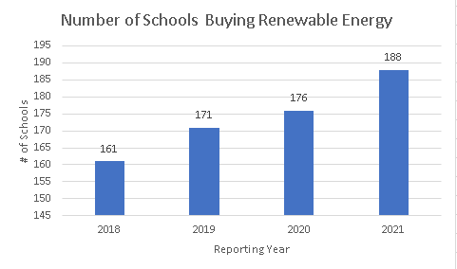
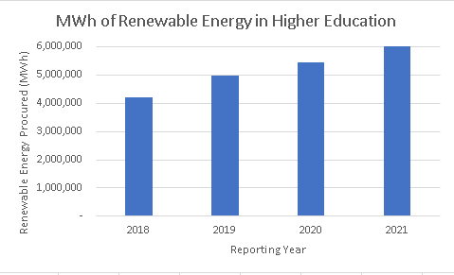
Trends: Total Renewables Growth in Higher Ed
The number of campuses buying RE grew 17% between 2018 and 2021
The volume of RE used by campuses grew 44% between 2018 and 2021
Notes:
Data is drawn from 470 schools that reported via STARS or the EPA between 2018-221
Number of schools procuring RE is likely higher; not all schools report via STARS or EPA
Schools claiming RE from grid mix only, but not specific sources, were not counted as renewable energy buyers
Schools pursuing long term RE solutions (e.g. VPPAs) were included in each year following the announcement of the purchase
Slight growth rate slowdown in number of schools from 2019 to 2020 likely due to COVID-19 pandemic

Slide 7
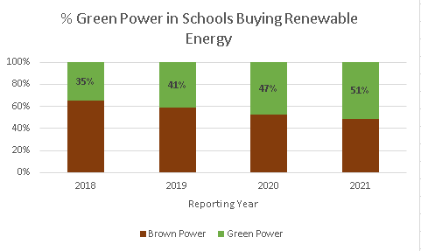
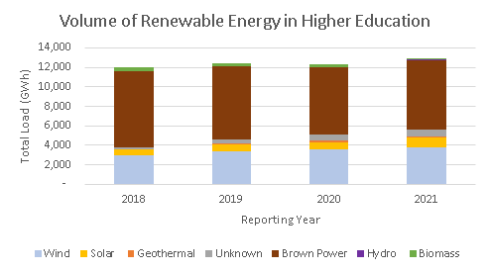
Trends: RE by Percent of Load & Source
Campus RE buyers increased their average RE purchase from 35% to 51% of their total load
Increase in wind procurement is driving the impact in total load of renewables
Brown power still dominates load, providing opportunity to improve total RE procurement
Notes:
Schools that were unable to determine source of RE were noted as unknown
Graph 1 illustrates data only from schools buying renewable energy, whereas graph 2 includes all schools reporting their energy data

Slide 8
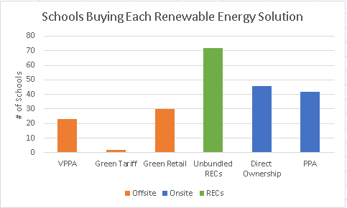
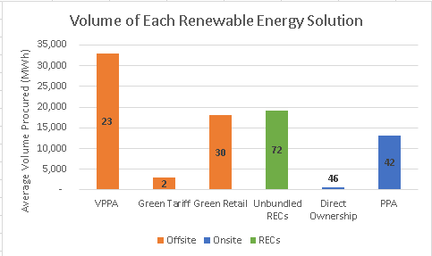
Trends: Renewables by Solution
Onsite solar is the most common way campuses source renewable energy
However, campus-owned onsite solar projects produce the least power of all RE sources
Offsite purchases have the largest impact
Notes:
Due to schools purchasing multiple ways, total number of schools is greater than 180
Smaller solutions referenced in dataset (e.g. biomass) not included due to zero reporting schools pursuing option
Average volume of RE procured derived from each campus’s most recent reporting year

Slide 9

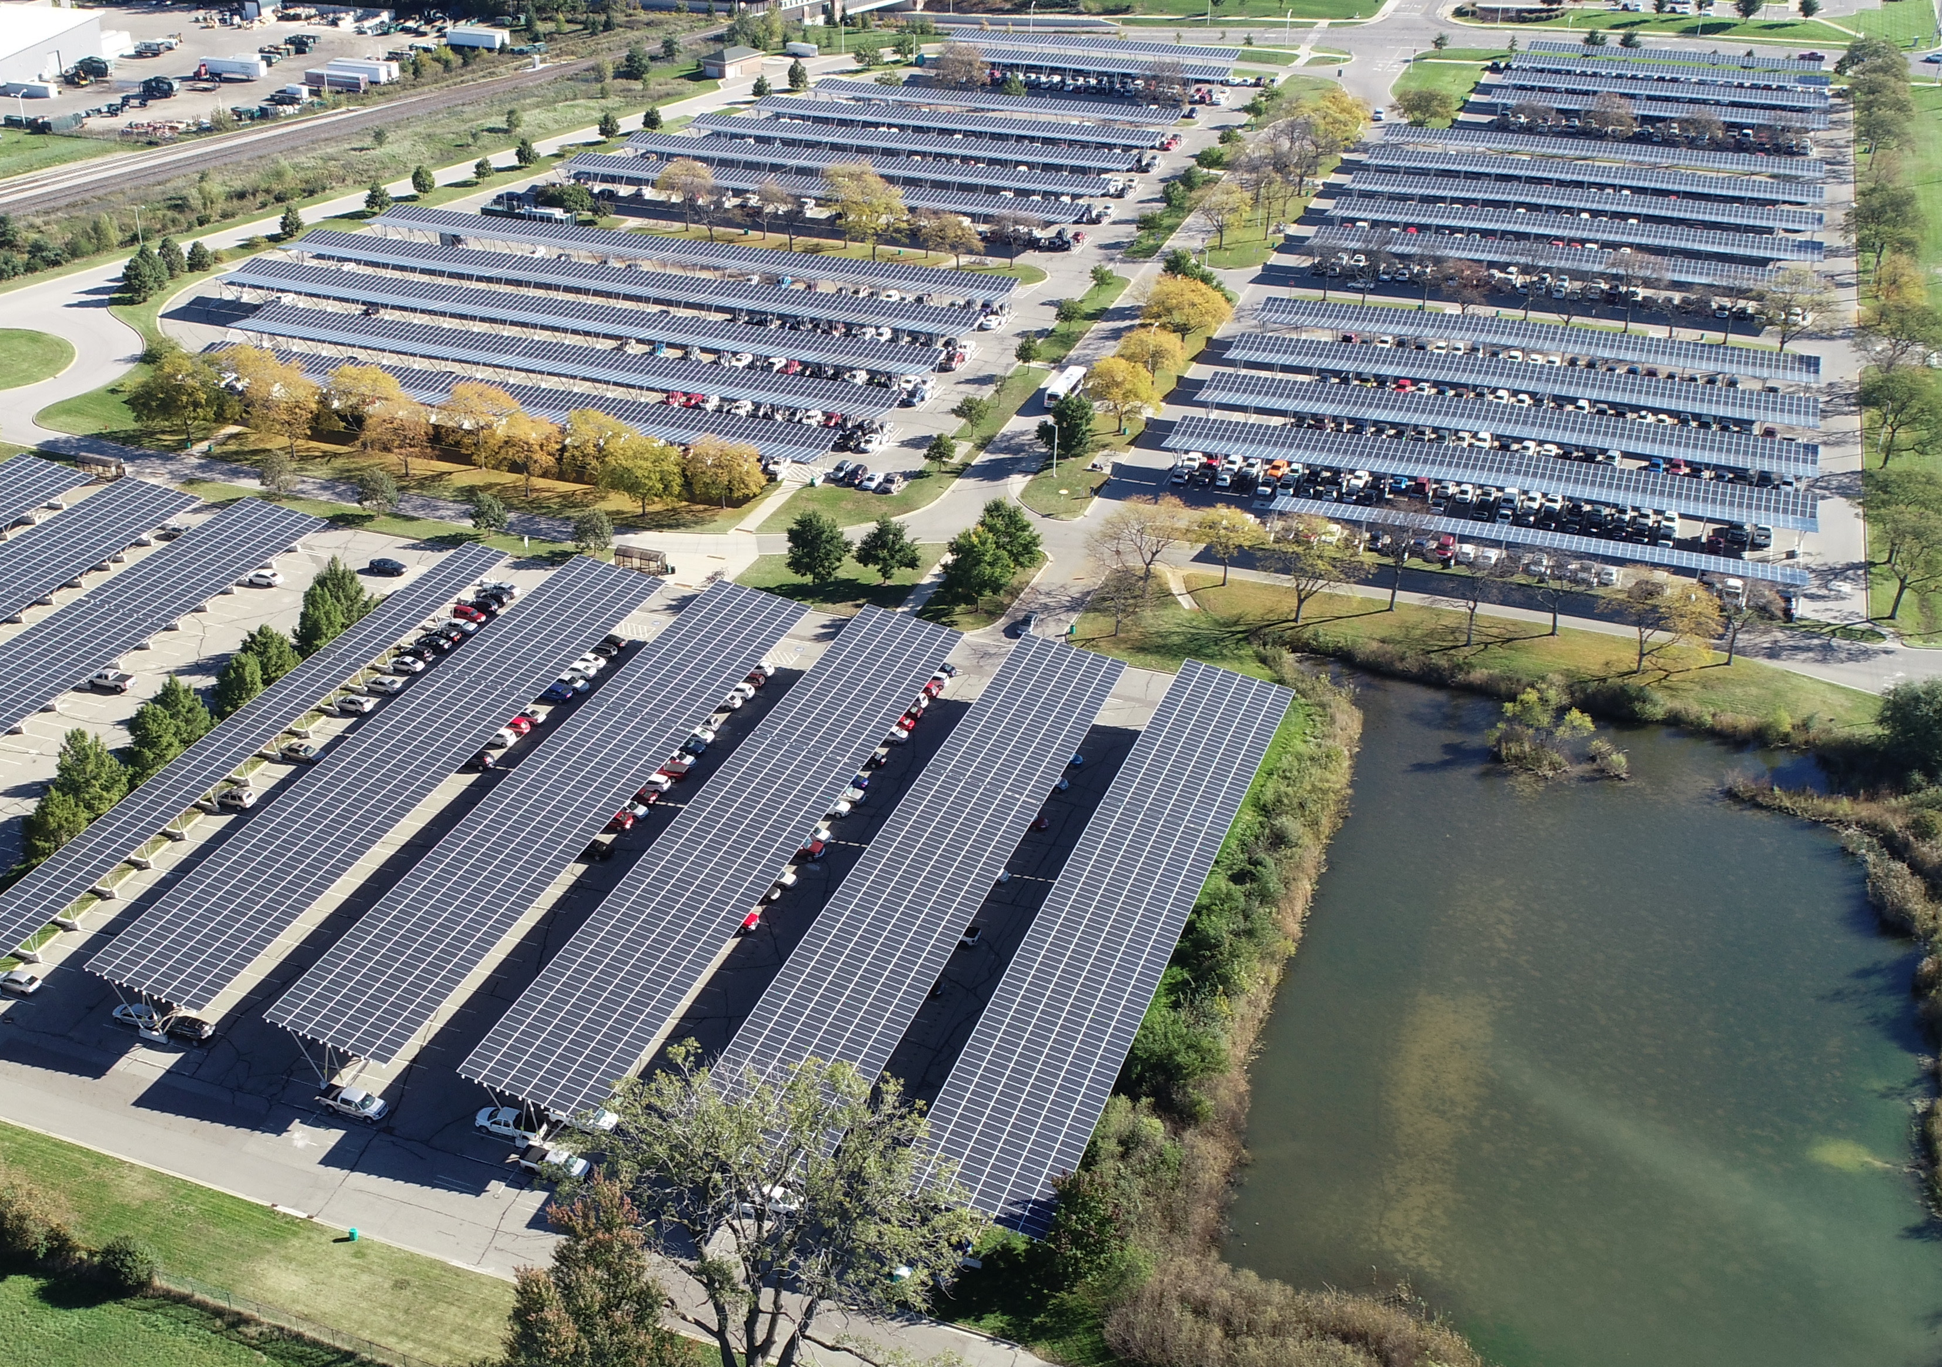
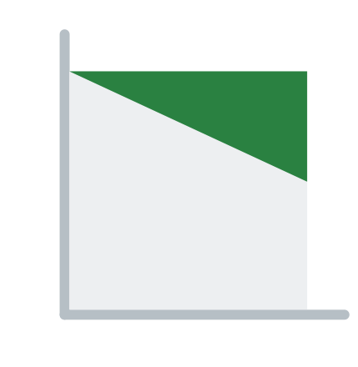

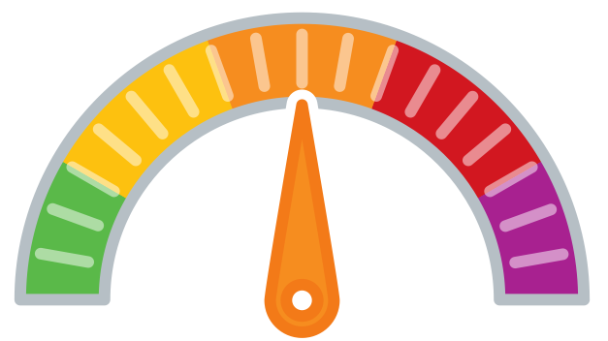
Michigan State University
Onsite Solar Carports Power Purchase Agreement
MSU constructed a 10.5 MW solar carport on five large commuter parking lots covering about 5,000 parking spaces. The 40,000-panel system annually generates 15,000 MWh of electricity from the sun while protecting cars from heat, rain, and snow.
The project was structured using a 25-year power purchase agreement with Inovateus Solar and Alterra Power, facilitated by Coho. Under the agreement, Inovateus and Alterra financed the construction of the facility and MSU will buy the electricity produced by the solar array. As a result, MSU expects to realize about $10 million in electricity cost savings over the project lifetime.
Construction started in March 2017 and was completed in December 2017. Since then, the project has received widespread recognition due to being the largest solar carport in North America.
GHG & Environmental Impact
Moderate
Project Timeline
1-2 Years
Project Feasibility
Some Challenges
Economic Impact & Savings
Net Savings
Publicity Impact
Wow,
amazing project

Slide 10

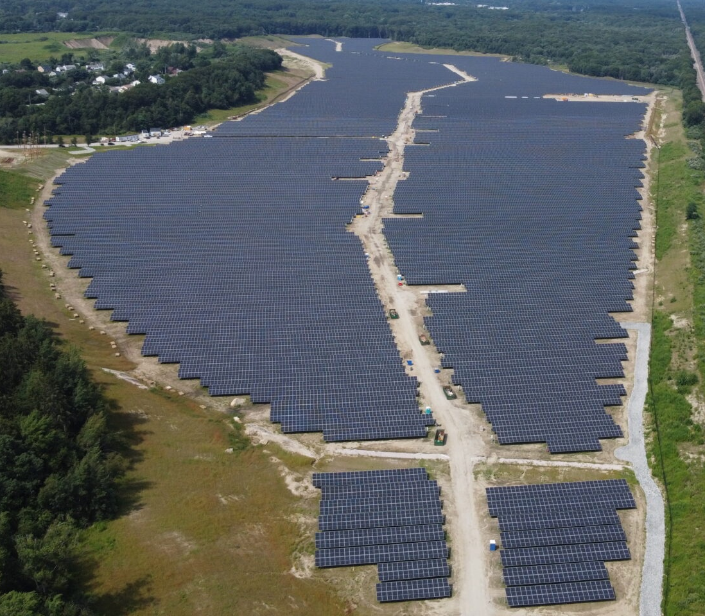
Brown University
Large-Scale Community Solar
In 2019 and 2021, Brown entered into three renewable electricity purchase agreements and one market-based wind project that will offset 100% of Brown’s on-campus electricity use through 2027. Electricity usage accounts for around forty percent of the University’s campus emissions. Like other community solar projects, the North Kingstown project is near campus, on a former gravel pit (photo at left), and it is financially integrated into Brown’s electricity bills. But, unlike other community solar projects, it is large at 50-megawatt (DC), and Brown is the sole offtaker, with the project generating the majority of campus electricity.
The remaining electricity use will be offset by two smaller R.I. solar projects and an agreement with a Texas-based wind farm, which began operating in summer 2020. Those projects, along with a thermal efficiency project completed in 2020, will cut campus emissions by approximately 27,000 metric tons per year — the equivalent of taking 5,800 cars off the road.
GHG & Environmental Impact Enormous
Project Timeline
2-3 Years
Project Feasibility
Some Challenges
Economic Impact & Savings
Net Savings
Publicity Impact
Wow,
amazing project

Slide 11

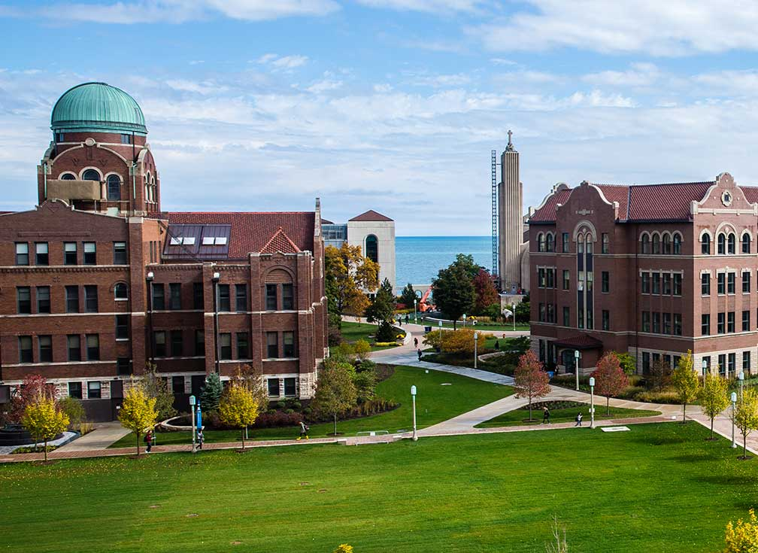
Loyola University Chicago
Renewable Energy Certificates & Retail Renewables
Loyola University Chicago began buying unbundled RECs in 2008 to meet LEED requirements for a building. With student support, Loyola increase its RECs to 35% (equivalent to residence hall usage), and finally 100% with increased budget support.
In 2022, Loyola, working with Coho, executed a 12-year retail renewables contract for 100% of its electricity, which will result in a new renewable energy project. Retail renewables can be smaller and shorter term than wholesale PPAs but are only available in deregulated markets. The project owner, Swift Current Energy, executed a PPA with Constellation Energy, which passed the energy, RECs, and project economics to Loyola on its retail electricity bill. Loyola will receive 80,000 MWh per year from the largest in Illinois’ 594 MW solar project at the end of 2024. Project co-benefits include:
Receiving project RECs through Illinois-specific self-direct program
Pollinator-friendly project status
Displacing more emissions in a dirtier grid (MISO) than local PJM grid
Educational agreement with project developer
Environmental justice and worker rights agreement (required by Self-Direct program)
GHG & Environmental Impact Enormous
Project Timeline
1-2 Years
Project Feasibility
Some Challenges
Economic Impact & Savings
Large Net Savings
Publicity Impact
Wow,
amazing project

Slide 12

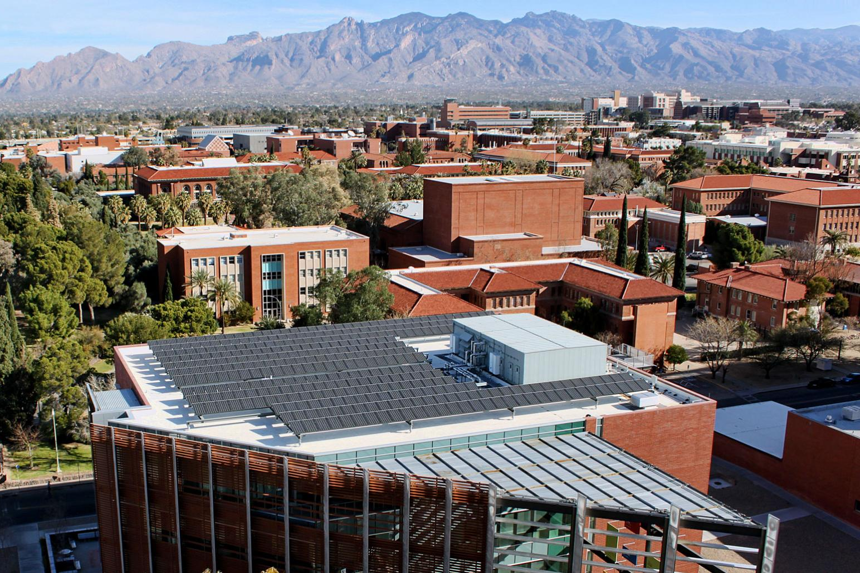

The University of Arizona
Utility Renewable Energy Agreement
The University of Arizona uses as much power as 22,000 average American homes. The University sought to source renewable energy to eliminate 100% of the greenhouse gas emissions associated with this electricity usage, ~ 65,000 MTCO2e per year, .
The University engaged Coho to guide the development and implementation of its renewable energy strategy. The result is a 20-year agreement with Tucson Electric Power (TEP) that will provide the university with 100% renewable electricity beginning in Spring 2021. Under the agreement, TEP will supply up to 26 megawatts (MW) of power from portions of two new projects. Half of the power will come from a 100 MW solar and storage facility at the Wilmot Energy Center in southeast Tucson, and the other half will come from the 250 MW Oso Grande Wind Project in southeastern New Mexico.
The agreement is the largest utility bilateral renewable energy agreement in the US between a university and a regulated utility and is expected to provide the University with significant savings compared to business-as-usual projections.
GHG & Environmental Impact Enormous
Project Timeline
1-2 Years
Project Feasibility
Difficult
Economic Impact & Savings
Large Net Savings
Publicity Impact
Wow,
amazing project

Slide 13


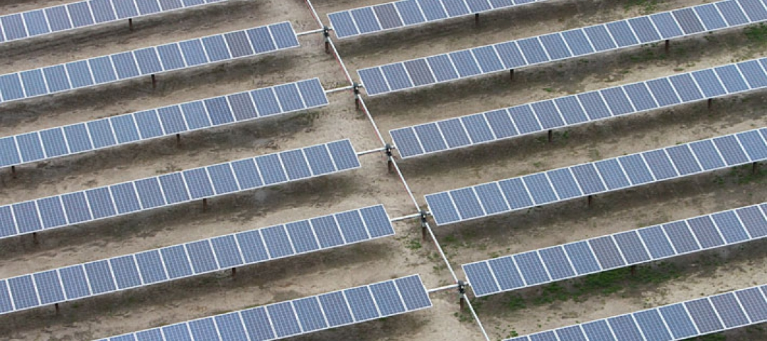

American University, George Washington University
Wholesale PPA
The Capital Partners Solar Project (CPSP) is a 20-year Power Purchase Agreement (PPA), advised by Coho, under which Duke Energy Renewables (DER) constructed a 52-megawatt solar photovoltaic (PV) array across three sites in North Carolina and sells the electricity generated to the George Washington University, American University, and the George Washington University Hospital.
Commercial operations of the first phase in Pasquotank County near Elizabeth City began in 2015, with second and third sites following in 2016. In its first year of operation, the project generated about 123 million kilowatt-hours (kWh) of emissions-free electricity, providing about half the electricity needs of GWU and AU, and about 30% needed by GWUH. Since the project did not require any upfront capital from the universities or hospital and the electricity is expected to cost less than the market, the institutions could potentially avoid millions of dollars in expected electric rate increases over the life of the project. The institutions found that this scale provided the best combination of reducing exposure to the volatility of future market prices while still reaching the scale necessary for the most competitive prices.
GHG & Environmental Impact Enormous
Project Timeline
2-5 years
Project Feasibility
Difficult
Economic Impact & Savings
Large Net Savings
Publicity Impact
Wow,
amazing project

Slide 14

Emerging Trends
There are new renewable energy buying strategies on the horizon
24/7 Load Matching PPAs seek to generate renewable energy in the volume and at the time the buyer is consuming electricity rather than matching annual or monthly demand volumes
Grid Carbon Intensity varies from location to location. A number of campuses have sought to calculate the actual avoided emissions from their VPPA projects in addition to deducting their GHGs on a one MWh-to-one MWh basis
Co-benefits are the social and environmental benefits of renewable energy projects beyond the greenhouse gas benefits. For example, some buyers are beginning to ask sellers about workforce development, domestic equipment production, site environmental impacts such as tree-removal or pollinator habitat, and project location in historic energy communities.

Slide 15

AASHE & Coho
Partners advancing sustainability and climate action in higher education
Advancing Sustainability in Higher Education
AASHE empowers higher education faculty, administrators, staff and students to be effective change agents and drivers of sustainability innovation. We work with and for higher education to ensure that our world’s future leaders are motivated and equipped to solve sustainability challenges.
Catalysts for Bold Climate Action
Coho, an ERM Group Company, (formerly CustomerFirst Renewables) works at the intersection of rigorous analysis and relationship-building. And we’re motivated by one thing: helping our clients achieve meaningful, real-life impact on climate change and water sustainability. That’s what makes us trusted advisors to dozens of major colleges, universities, and corporations.

